Slide 1

REACTIVE
SPRING 5

Slide 2



WHO Am i?
SE at Levi9
5+ dev experience
Spring fan
/OlegDokuka
/oleh.dokuka

Slide 3
Agenda
Spring 5 Road-Map
5.0 M1-M4
5.0 RC1
5.X
Q&A
Reactive Spring
Brief of history and problems
Reactive-Streams Community
Project Reactor
Reactive Web
Demo
Q&A

Slide 4
Spring 5
Road MAP

Slide 5

Framework
Generation
5.0 M1 JULY 2016
5.0 RC1 December 2016
5.0 GA Q1 2017

Slide 6

Framework
Generation
5.0 M1 JULY 2016
5.0 RC1 December 2016
5.0 GA Q1 2017

Slide 7


Base Line
JDK 8+, Servlet API 3.1+, JPA 2.1+, JUnit 5

Slide 8
5.0 m1

Slide 9

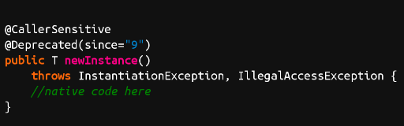

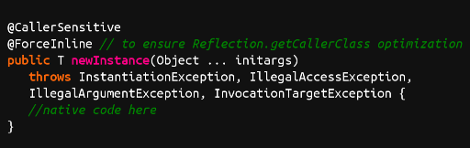
5.0 m1
Constructor based instantiation
Class.newInstance()
Constructor.newInstance()

Slide 10
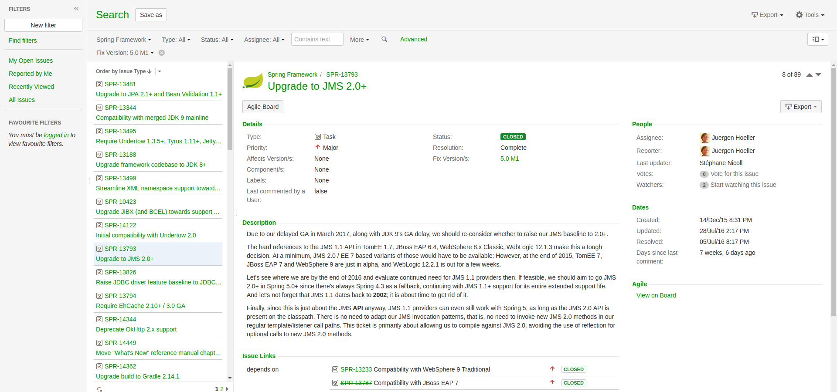
5.0 m1
Constructor based instantiation
JMS 2.0

Slide 11
5.0 m1
Constructor based instantiation
JMS 2.0
Upgrade to JPA 2.1+ and Bean Validation 1.1+ (Hibernate ORM 5.0+, Hibernate Validator 5.0+, EclipseLink 2.5+)

Slide 12
5.0 m1
Constructor based instantiation
JMS 2.0
Upgrade to JPA 2.1+ and Bean Validation 1.1+ (Hibernate ORM 5.0+, Hibernate Validator 5.0+, EclipseLink 2.5+)
Reactive client and server HTTP adapters

Slide 13
5.0 m2

Slide 14
5.0 m2
Support for RxJava 2

Slide 15

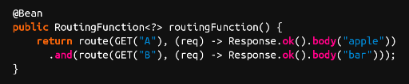

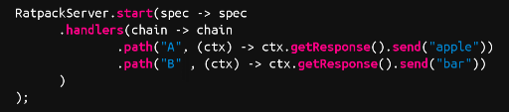
5.0 m2
Support for RxJava 2
New controller for Spring MVC using Lambda
Spring
Ratpack

Slide 16

5.0 m2
Support for RxJava 2
New controller for Spring MVC using Lambda
Upgrade build to Gradle 3.0

Slide 17
5.0 m2
Support for RxJava 2
New controller for Spring MVC using Lambda
Upgrade build to Gradle 3.0
Reactive Web improvements

Slide 18
5.0 m3-M4

Slide 19
5.0 m3-M4
Reactive Web improvements
Reactive Web Socket
JUnit 5 integration improvements

Slide 20
5.0-RC1

Slide 21
5.0-RC1
Spring Framework jars on the JDK 9 module path

Slide 22
5.X

Slide 23

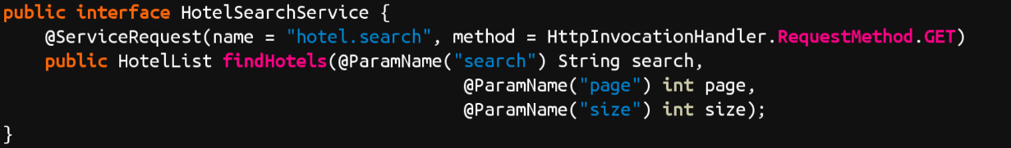
5.X
Spring MVC REST client

Slide 24
5.X
Spring MVC REST client
JSR 365 (CDI 2.0) - new dependency injection API support

Slide 25
5.X
Spring MVC REST client
JSR 365 (CDI 2.0) - new dependency injection API support
Servlet 4.0

Slide 26
5.X
Spring MVC REST client
JSR 365 (CDI 2.0) - new dependency injection API support
Servlet 4.0
JMS 2.1

Slide 27
5.X
Spring MVC REST client
JSR 365 (CDI 2.0) - new dependency injection API support
Servlet 4.0
JMS 2.1
Full JDK 9 compatibility

Slide 28
5.X
Spring MVC REST client
JSR 365 (CDI 2.0) - new dependency injection API support
Servlet 4.0
JMS 2.1
Full JDK 9 compatibility
Parallel bean initialization during startup

Slide 29
Q&A

Slide 30
Resources
https://goo.gl/pavuV5 - Spring Framework JIRA Dashboard
https://goo.gl/UQ4zpe - Spring Framework 5.0 M1 released
https://goo.gl/zMVc9U - SpringOne Platform 2016 Keynote - Spring 5

Slide 31



Slide 32
Callback

Slide 33

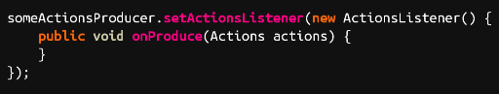
Callback

Slide 34

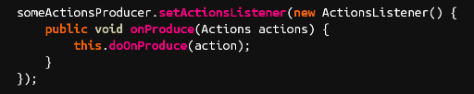
Callback

Slide 35

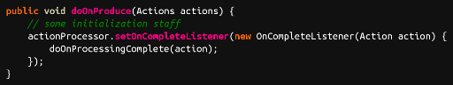
Callback

Slide 36

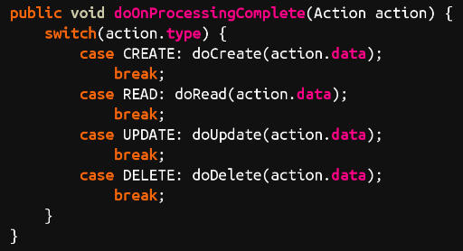
Callback

Slide 37


Callback

Slide 38


Slide 39


Slide 40


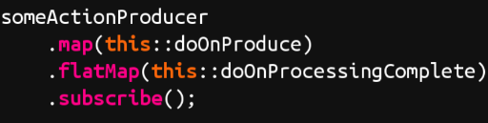
Map Actions
Run the flow
Process Actions and aggregate results

Slide 41


Slide 42

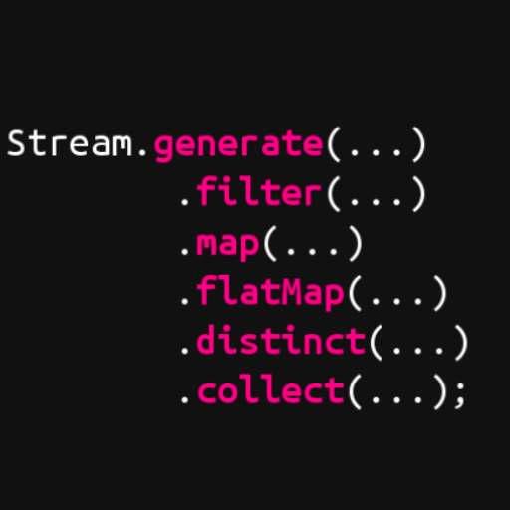
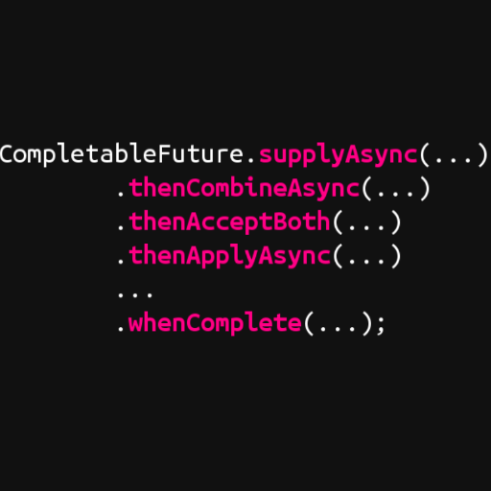
Reactive Java 8
but not enough
java.util.concurrent.
java.util.stream.
CompletionStage
Stream

Slide 43
«
there is no single best fluent
async/parallel API. CompletionStage best supports
continuation-style programming on futures, and java.util.stream best
supports (multi-stage, possibly-parallel) "pull" style operations on
the elements of collections. ... one missing category was
"push"
— Doug Lee
»

Slide 44

Unsolved problems
in-stream communication
backpressure
no common api

Slide 45


Slide 46


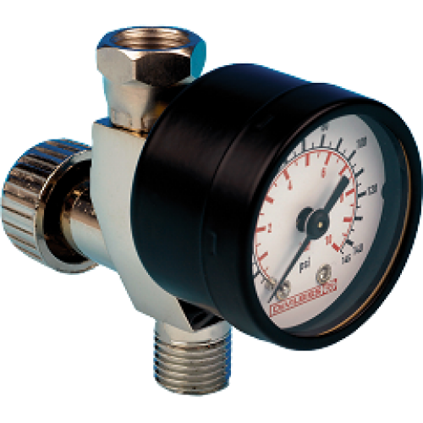
REACTIVE streams
subscription
Publisher
Subscriber

Slide 47



One Api

Slide 48

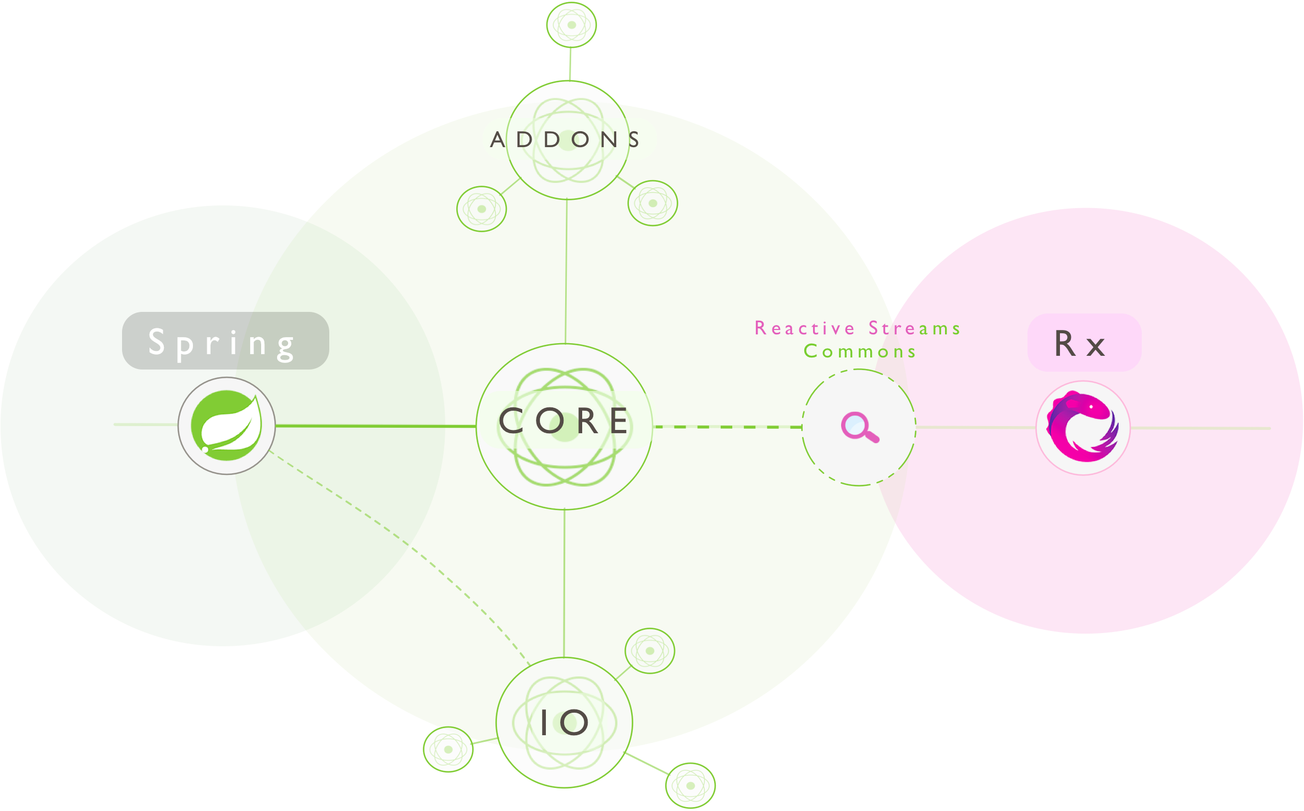

Slide 49
Project reactor
CompletionStage………………..
Mono
Stream…………………………..…
Flux

Slide 50







Reactive efforts

Slide 51
@Controller, @RequestMapping,…
Spring MVC
Spring Web Reactive
Servlet API
Reactive HTTP
Servlet Container
Servlet, Netty, Undertow

Slide 52

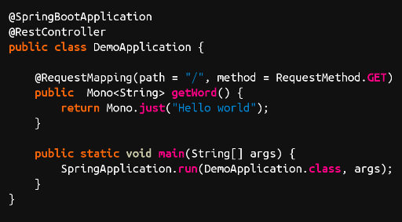

Slide 59
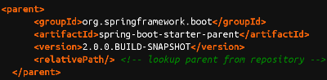

Slide 60
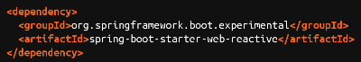

Slide 61
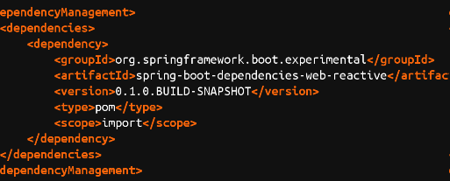

Slide 62

DEMO

Slide 63


DEMO BASED ON
Weather APP
That
Created by

Slide 64
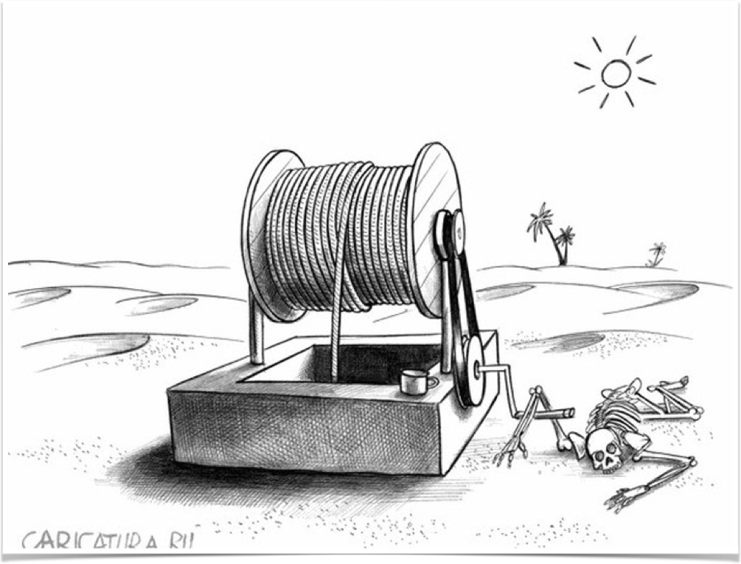

Slide 66
Q&A

Slide 67
Resources
https://goo.gl/M0vMxT - Generations of Reactivity
https://goo.gl/8ZgrHw - Reactive Web
https://youtu.be/Xm-KjMY_Z_w?list=PLAdzTan_eSPQ1fuLSBhyB4eEZF7JQM0Mx - SpringOne Platform 2016 Keynote - Reactive Spring
https://goo.gl/bIwZxn - Reactive Streams GitHub
https://youtu.be/Cj4foJzPF80 - Developing Reactive applications with Reactive Streams and Java 8

Slide 68
Thank you

